Slide 1

RESPONSIVE WEBSITE DESIGN
WEB APPLICATION DEVELOPMENT TRAINING

Slide 2

Device Categories
  Devices are categorized into four on the basis of their width. We have extra small devices (xs), small devices(sm), medium devices(md) and large devices (lg).
  Bootstrap provides different notation based on these categories and defines CSS classes on the basis of that.
Notes:
Talk about the history a bit: mention the fixed width era, the % width specification era, the era of having mobile version of websites and then where we are: responsive apps

Slide 3
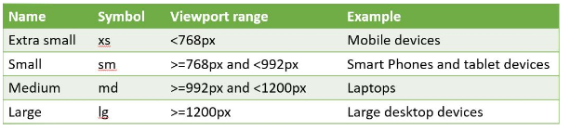
Device Categories
Notes:
Talk about the history a bit: mention the fixed width era, the % width specification era, the era of having mobile version of websites and then where we are: responsive apps

Slide 4
The Website Layout Classes
There are 3 important classes used in laying out a bootstrap webpage
The Container Class
The Row Class
The Column Class

Slide 5
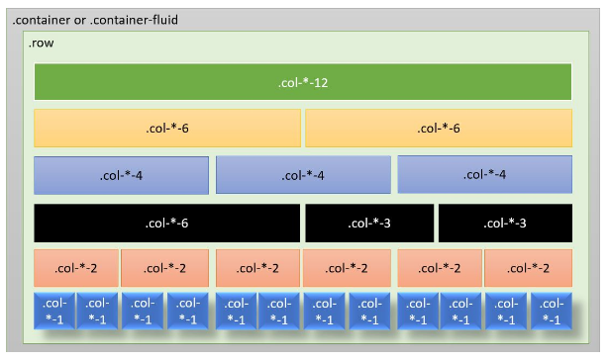
The Grid System
  Bootstrap provides 12 column grid layout structure to make the layout responsive. Bootstrap divides the complete device width into 12 columns. A number specified with the class represents the element having that class will take the specified number of column space of total 12 column.
Notes:
Talk about the history a bit: mention the fixed width era, the % width specification era, the era of having mobile version of websites and then where we are: responsive apps

Slide 6
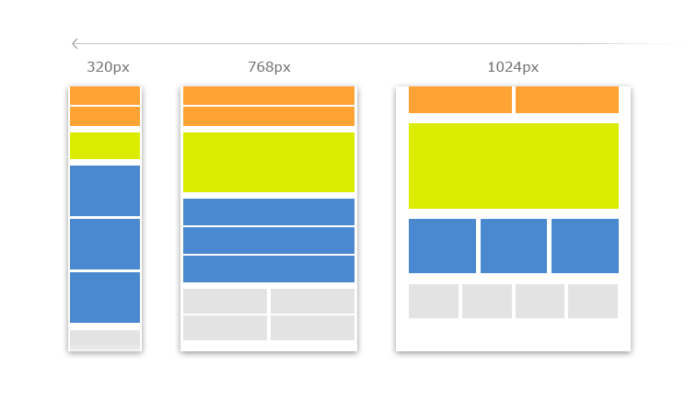
Responsive Website Layout – Target Devices
Notes:
The grids will stack when viewed from devices that are smaller than the target device.
You can specify more than one device class for a single div

Slide 7
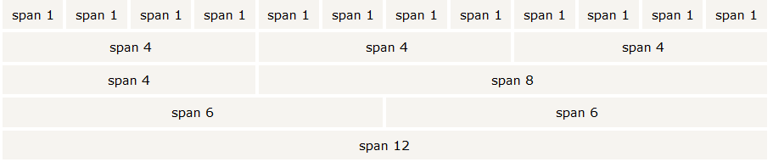
The Bootstrap Grid System
  Just as you have your web contents enclosed inside the table tag when using table layout
  <table>
    <tr><td> Contents </td></tr>
  </table>
  Bootstrap makes use of a grid system that imaginarily divides the screen to 12 columns

Slide 8
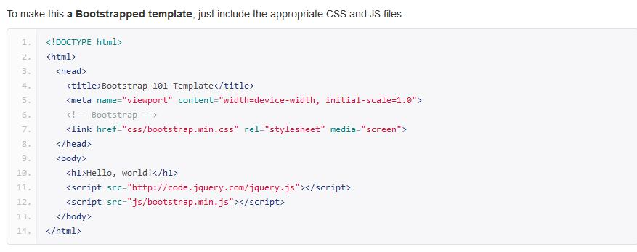
Making your website responsive- Include the necessary files

Slide 9
Tips – The parts Explained
  JS at the bottom-It’s a good practice to include at the lower part of the page as js loads slower than css
  Since JS is for interactivity, it is safe to allow our layout loads completely before the JS.
  Inclusion from the server: Bootstrap files are standard library available on the bootstrap server, you may reference this version of the file by specifying in the href attribute as you can see the jquery inclusion
  Jquery before Bootstrap JS : the bootstrap js files need jquery library to work hence jquery comes before js

Slide 10
The Bootstrap Grid System Further Explained
  In bootstrap, the layout of your webpage is set with 3 very important classes.
  You wrap your contents with:
<div class=“container”>
<div class=“row”>
<div class=“col-x-[1-12]”> Contents </div>
</div>
</div>
col-x-[1-12] : x is the target device and can have values (xm,sm,md,lg)

Slide 11
The Bootstrap Grid System Further Explained
  The numerical values just like colspan can be used to merge grids
  The container class can be container-fluid to make the container occupy the whole of the screen. Compare the two in your IDE

Slide 12

Responsive Embed
This is used to make videos or slideshows scale properly on any device.
Classes can be applied directly to <iframe>, <embed>, <video>, and <object> elements.
Create a responsive embed by adding an .embed-responsive-item class to an <iframe> tag
The containing <div> defines the aspect ratio of the video.
The aspect ratio of an image describes the proportional relationship between its width and its height. Two common video aspect ratios are 4:3 (universal video format),and 16:9 (universal for HD television)
Notes:
Tool for generating responsive embed : http://embedresponsively.com/

Slide 13
Responsive Embed
<div class="embed-responsive embed-responsive-4by3">
<iframe class="embed-responsive-item“ src="...">
</iframe>
</div>
Exercises: Design a web page that has two columns, embed a responsive youtube video in one of the divs
Notes:
Responsive Mode on :
Firefox: Crl+Shift+M
Chrome: From Developer Tools >> Select the mobile icon

Slide 14
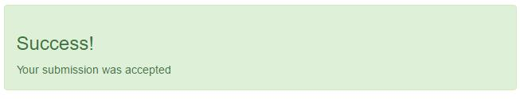
Alert Class
Alerts are created with the .alert class, followed by one of .alert-success, .alert-info, .alert-warning or .alert-danger
<div class="alert alert-success">
<h3>Success!</h3>Your submission was accepted
</div>
Will show as follows:

Slide 15
Alert Class
To close the alert message, add a .alert-dismissible class to the alert container.
Then add class="close" and data-dismiss="alert" to a link or a button element that you can click on to close the alert
<div class="alert alert-success alert-dismissible">
<a href="#" class="close" data-dismiss="alert" aria-label="close">&times;</a>
<strong>Success!</strong> Indicates a successful or positive action.
</div>

Slide 16
Alert Class
The .fade and .in classes adds a fading effect when closing the alert message
Exercise:
Design a simple page with alert, try out the different possibilities of Bootstrap alert class

Slide 17
The Carousel Plugin
The Carousel plugin is a component for cycling through elements like slideshow.
Uses CSS3 transitions and animations to achieve the slide effect
Plugins can be included individually using Bootstrap's individual "carousel.js" file or all using "bootstrap.js" or bootstrap.min.js“
Carousels are not supported properly in Internet Explorer 9 and earlier.
Notes:
Check the attached carousel code snippet and us as it is.

Slide 18
Parts of the Carousel Plugin
The outermost <div>:
Carousels require the use of an id for the controls to function properly.
The class="carousel" specifies that this <div> contains a carousel.
The .slide class adds a CSS transition and animation effect, which makes the items slide when showing a new item. Omit this class if you do not want this effect.
The data-ride="carousel" attribute tells Bootstrap to begin animating the carousel immediately when the page loads.

Slide 19
Parts of the Carousel
The "Indicators" part:
The indicators are the little dots at the bottom of each slide (which indicates how many slides there is in the carousel, and which slide the user are currently viewing).
The indicators are specified in an ordered list with class .carousel-indicators.
The data-target attribute points to the id of the carousel.
The data-slide-to attribute specifies which slide to go to, when clicking on the specific dot.

Slide 20
Parts of the Carousel
The "Wrapper for slides" part:
The slides are specified in a <div> with class .carousel-inner.
The content of each slide is defined in a <div> with class .item. This can be text or images.
The .active class needs to be added to one of the slides. Otherwise, the carousel will not be visible.

Slide 21
Parts of the Carousel
The "Left and right controls" part:
This code adds "left" and "right" buttons that allows the user to go back and forth between the slides manually.
The data-slide attribute accepts the keywords "prev" or "next", which alters the slide position relative to its current position.

Slide 22
Exercise
Based on the Carousel template provided to you, design a responsive website with a 3 image-carousel as the banner.
On the website, let their be two columns one containing a responsive video and another texts

Slide 23
Adding Caption to Slides on Carousel
Add <div class="carousel-caption"> within each <div class="item"> to create a caption for each slide as follows:
<div class="carousel-caption">
<h3>Chania</h3>
<p>The is a cross section of Moat Academy HTML Lesson</p>
</div>

Slide 24
Modal
Exercise: Do a sign up and/or Registration form in modal
Use Modal to load a Terms and Condition div

Slide 25
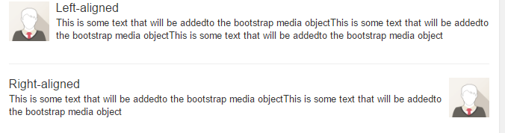
Bootstrap Media Objects
Bootstrap provides an easy way to align media objects (like images or videos) to the left or to the right of some content.
It can be used to display blog comments, tweets and so on
Can Be Nested

Slide 26
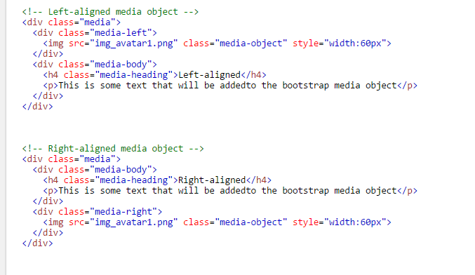
Bootstrap Media Objects

Slide 27
Bootstrap Forms
Allows you to format your form elements
The .form-control class when used on your input element gives you a 100% width.
Wrap labels and form controls in <div class="form-group"> for optimum spacing
Add class .form-control to all textual <input>, <textarea>, and <select> elements
See Example:

Slide 28
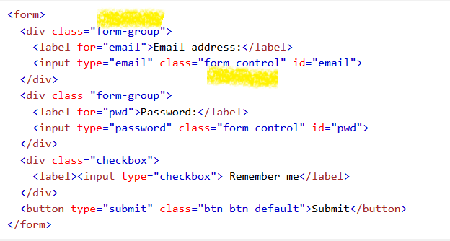
Bootstrap Forms

Slide 29
Bootstrap Forms
Your form can have any of 3 layouts below:
  Vertical form (this is default)
  Horizontal form
  Inline form
Add class=“form-inline” to the form to make it an inline form etc
Its good to use label to lay out the form elements to help screen readers. To hide label except screen readers. Add the class= “sr-only” to your label

Slide 30
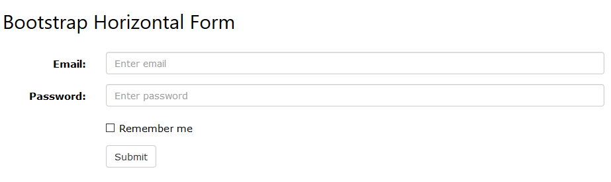
Bootstrap Forms
For horizontal forms, add .control-label class to all labels
Use Bootstrap's predefined grid classes to align labels and groups of form controls in a horizontal layout.

Slide 31
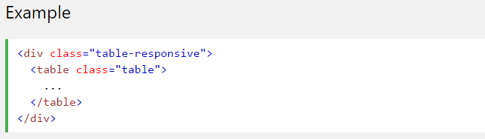
Bootstrap Tables
The .table-responsive class creates a responsive table. The table will then scroll
horizontally on small devices (under 768px). When viewing on anything larger than 768px
wide, there is no difference:

Slide 32
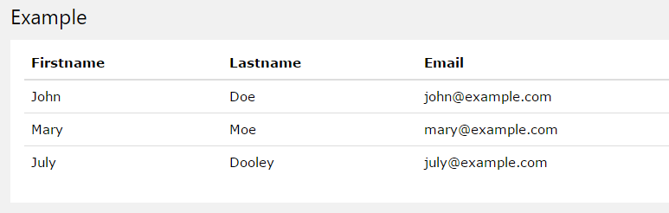
Bootstrap Tables
A basic Bootstrap table has a light padding and only horizontal dividers.
The .table class adds basic styling to a table:

Slide 33
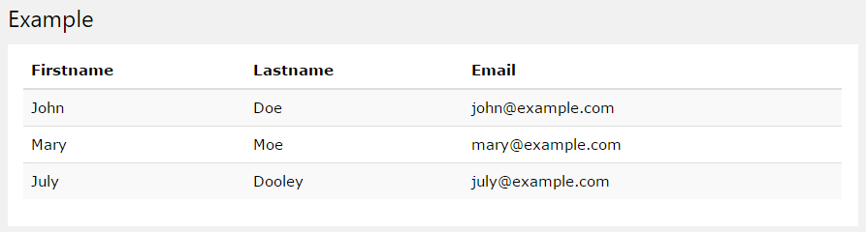
Bootstrap Tables
Striped Rows
The .table-striped class adds zebra-stripes to a table:

Slide 34
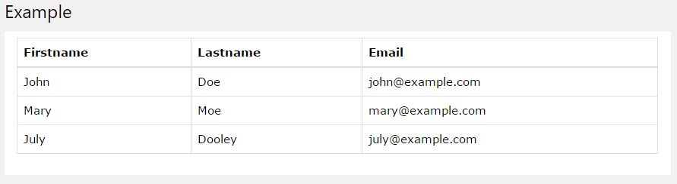
Bootstrap Tables
Bordered Table
The .table-bordered class adds borders on all sides of the table and cells:

Slide 35
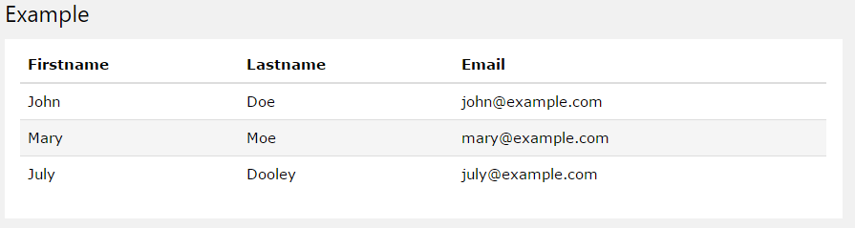
Bootstrap Tables
Hover Rows
The .table-hover class adds a hover effect (grey background color) on table rows:

Slide 36
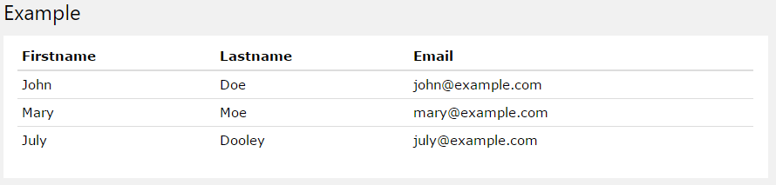
Condensed Table
The .table-condensed class makes a table more compact by cutting cell padding in half:

Slide 37
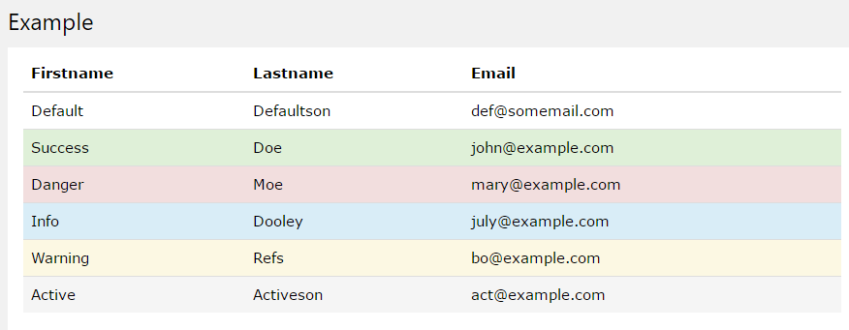
Bootstrap Tables
Contextual Classes
Contextual classes can be used to color table rows (<tr>) or table cells (<td>):

Slide 38
Bootstrap Text/Typography
  Bootstrap's global default font-size is 14px, with a line-height of 1.428.
  This is applied to the <body> and all paragraphs.
  In addition, all <p> elements have a bottom margin that equals half their computed line-height (10px by default).

Slide 39
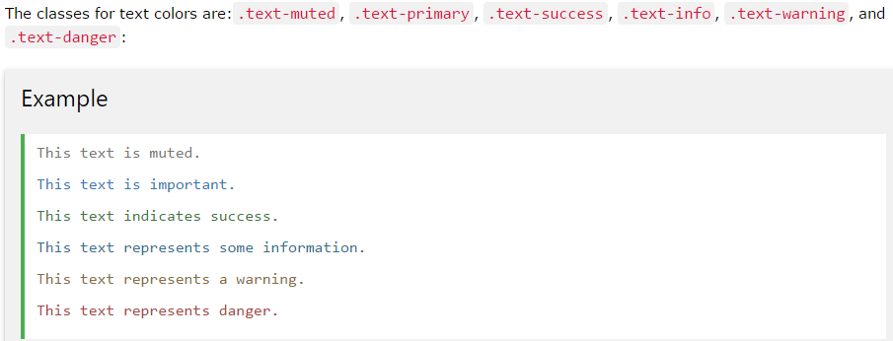
Contextual Colors and Backgrounds
Bootstrap also has some contextual classes that can be used to provide "meaning through
colors".

Slide 40
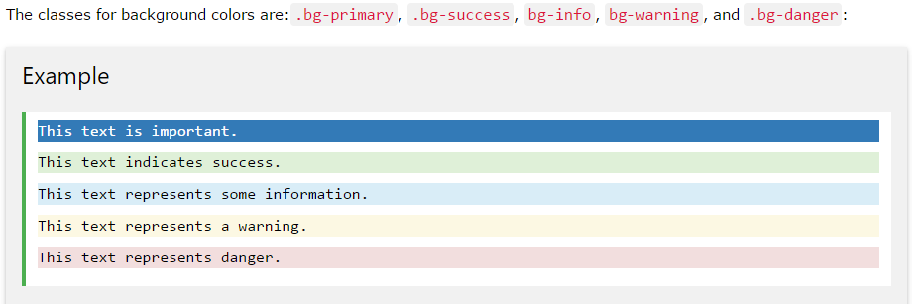
Contextual Colors and Backgrounds
Bootstrap also has some contextual classes that can be used to provide "meaning through
colors".

Slide 41
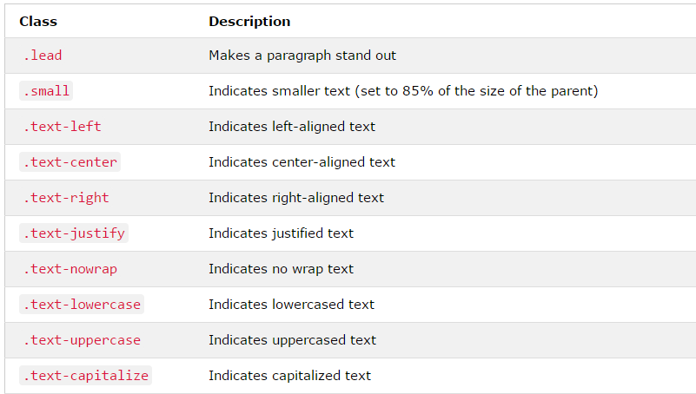
Creating Responsive Website using Bootstrap
The Bootstrap classes below can be added to style HTML elements further:
More Typography Classes

Slide 42
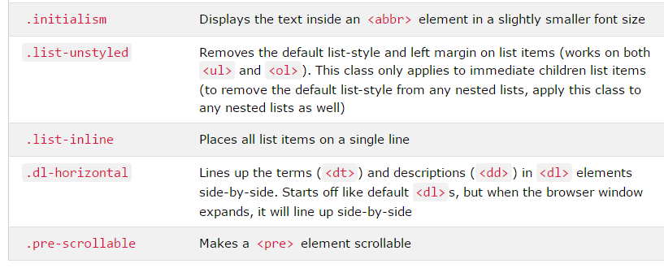
More Typography Classes
The Bootstrap classes below can be added to style HTML elements further:

Slide 43
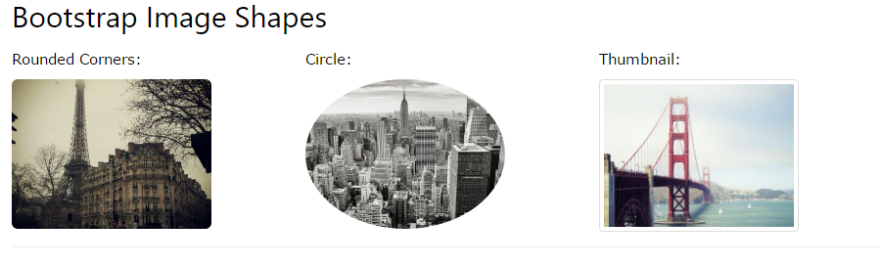
Bootstrap Images
To make an image responsive, just add the class “img-responsive” to it

Slide 44
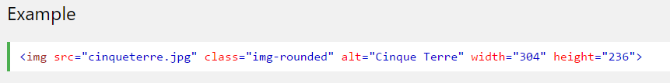

Bootstrap Images: Rounded Corners
The .img-rounded class adds rounded corners to an image (IE8 does not support
rounded corners):
Note that you don’t need to set the dimension of the image if you use the img-responsive class

Slide 45
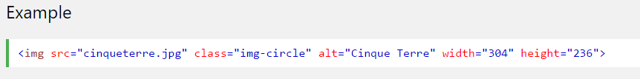

Bootstrap Images: Circle
The .img-circle class shapes the image to a circle (IE8 does not support rounded corners):
Notes:
Note that you don’t need to set the dimension of the image if you use the img-responsive class

Slide 46
Making Your website more beautiful with Icons
Icons add meaning to your web contents. – Easy to understand without reading any manual!
Icons always have pre-defined dimension, you can get images for icons freely online (check the notes)
GLYPHICONS is a library of precisely prepared monochromatic icons and symbols.
Over 250 Glyphicons are available to Bootstrap free of charge
Use glyphicons in text, buttons, toolbars, navigation, or forms:
Official Website is: http://glyphicons.com/
Notes:
A full list of available glyhpicon icons in boostrap can be found on: http://getbootstrap.com/components/
You can get images suitable for icons on findicon.com, iconfinder.com, http://www.freeiconspng.com/

Slide 47
Making Your website more beautiful with Icons
Don’t combine with other components or class on the same element
Icon classes should only be used on elements that contain no text content and have no child elements.
Example usage is:
<span class="glyphicon glyphicon-envelope"></span>
Other Icons are font-awesome
Notes:
A good place to use a glyphicon is in a span
Font awesome website is http://fontawesome.io/

Slide 48
Making Your website more beautiful with Avatars
In computing, an avatar is the graphical representation of the user or the user's alter ego or character
http://www.avatarsdb.com for a free online database of free avatars
You can include avatars on your page to represent a character of a generic of character
Ponder: When you create account on facebook and you specify your gender as female, an avatar that represents female will be used until you upload your profile image

